Slide 1
VM simulator
Contributor:
Yufei Zhang, Lu Yan, Zhuojin Liu, Liting Zhou

Slide 2
Content
Design
TLB
OS
Page Table
Evaluation
Hypothesis
Test Result

Slide 3
Huge page support
Modern commercial CPUs, such as Intel and AMD ones, only support a few page sizes, typically 4KB, 2MB and 1GB.
We have nothing to worry about, so why not make it more interesting?
Our design: support all page sizes from 4KB to 1GB (by a factor of 2)

Slide 4
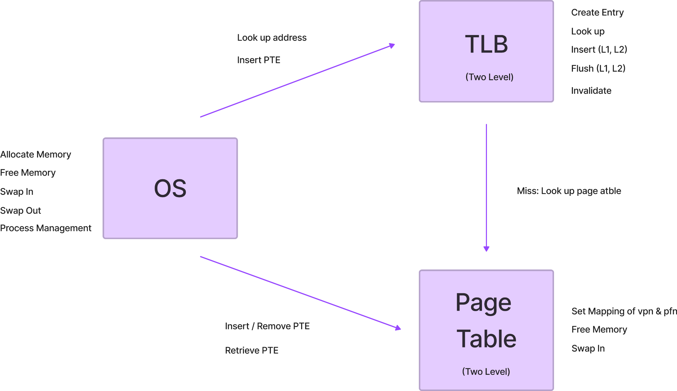

Slide 5
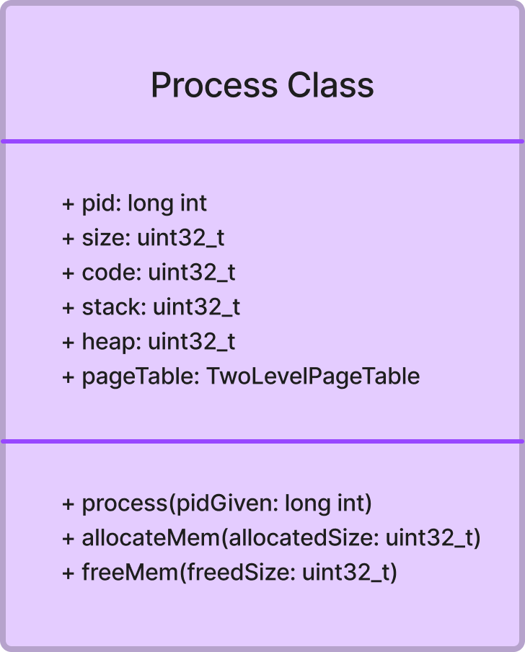
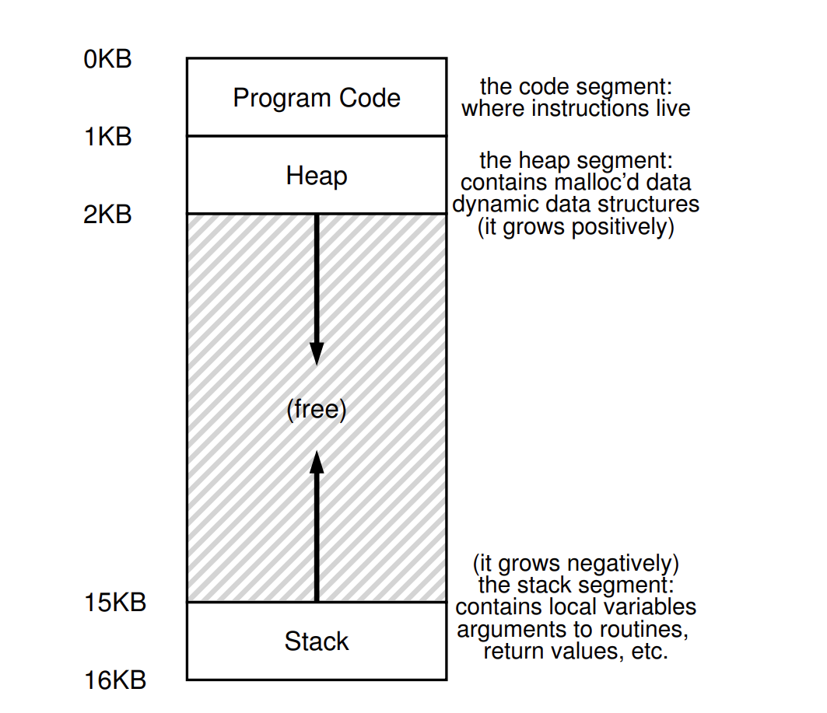
Process

Slide 6
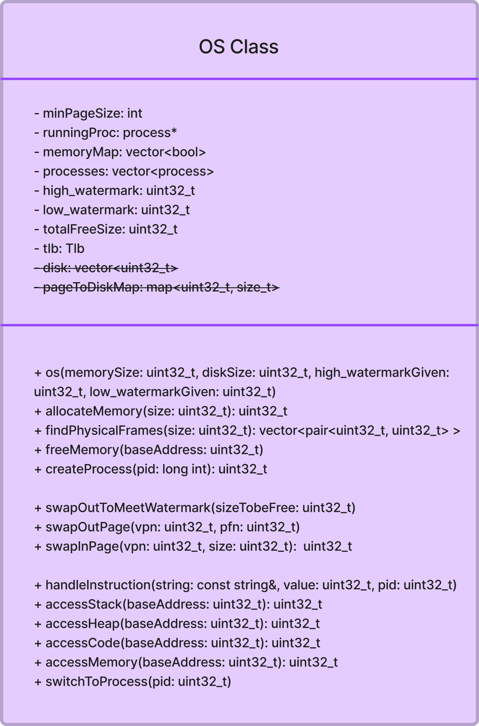
OS
Main functions of OS:
Allocate memory
Free memory
Create/Destroy/Switch process
Swap out page to meet Watermark
Swap in page when TLB miss
Notes:
Memory management, process management, instruction process (access memory/calculate hit times)

Slide 7
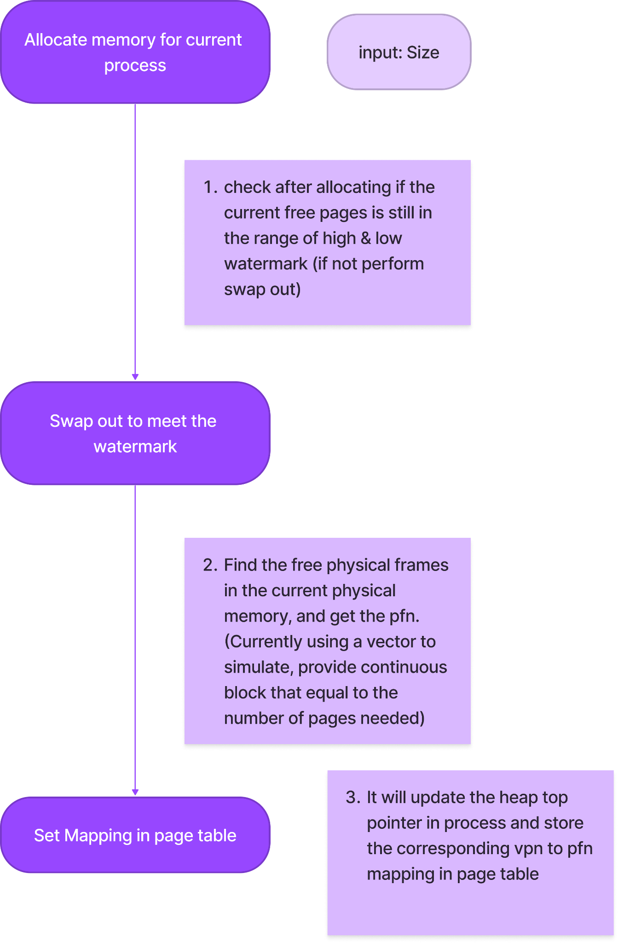
Allocate memory
Allocating the input amount of memory to current running process
Handles variable page size. If not able to find large enough contiguous block -> halving the size to perform recursion -> find non-contiguous memory

Slide 8
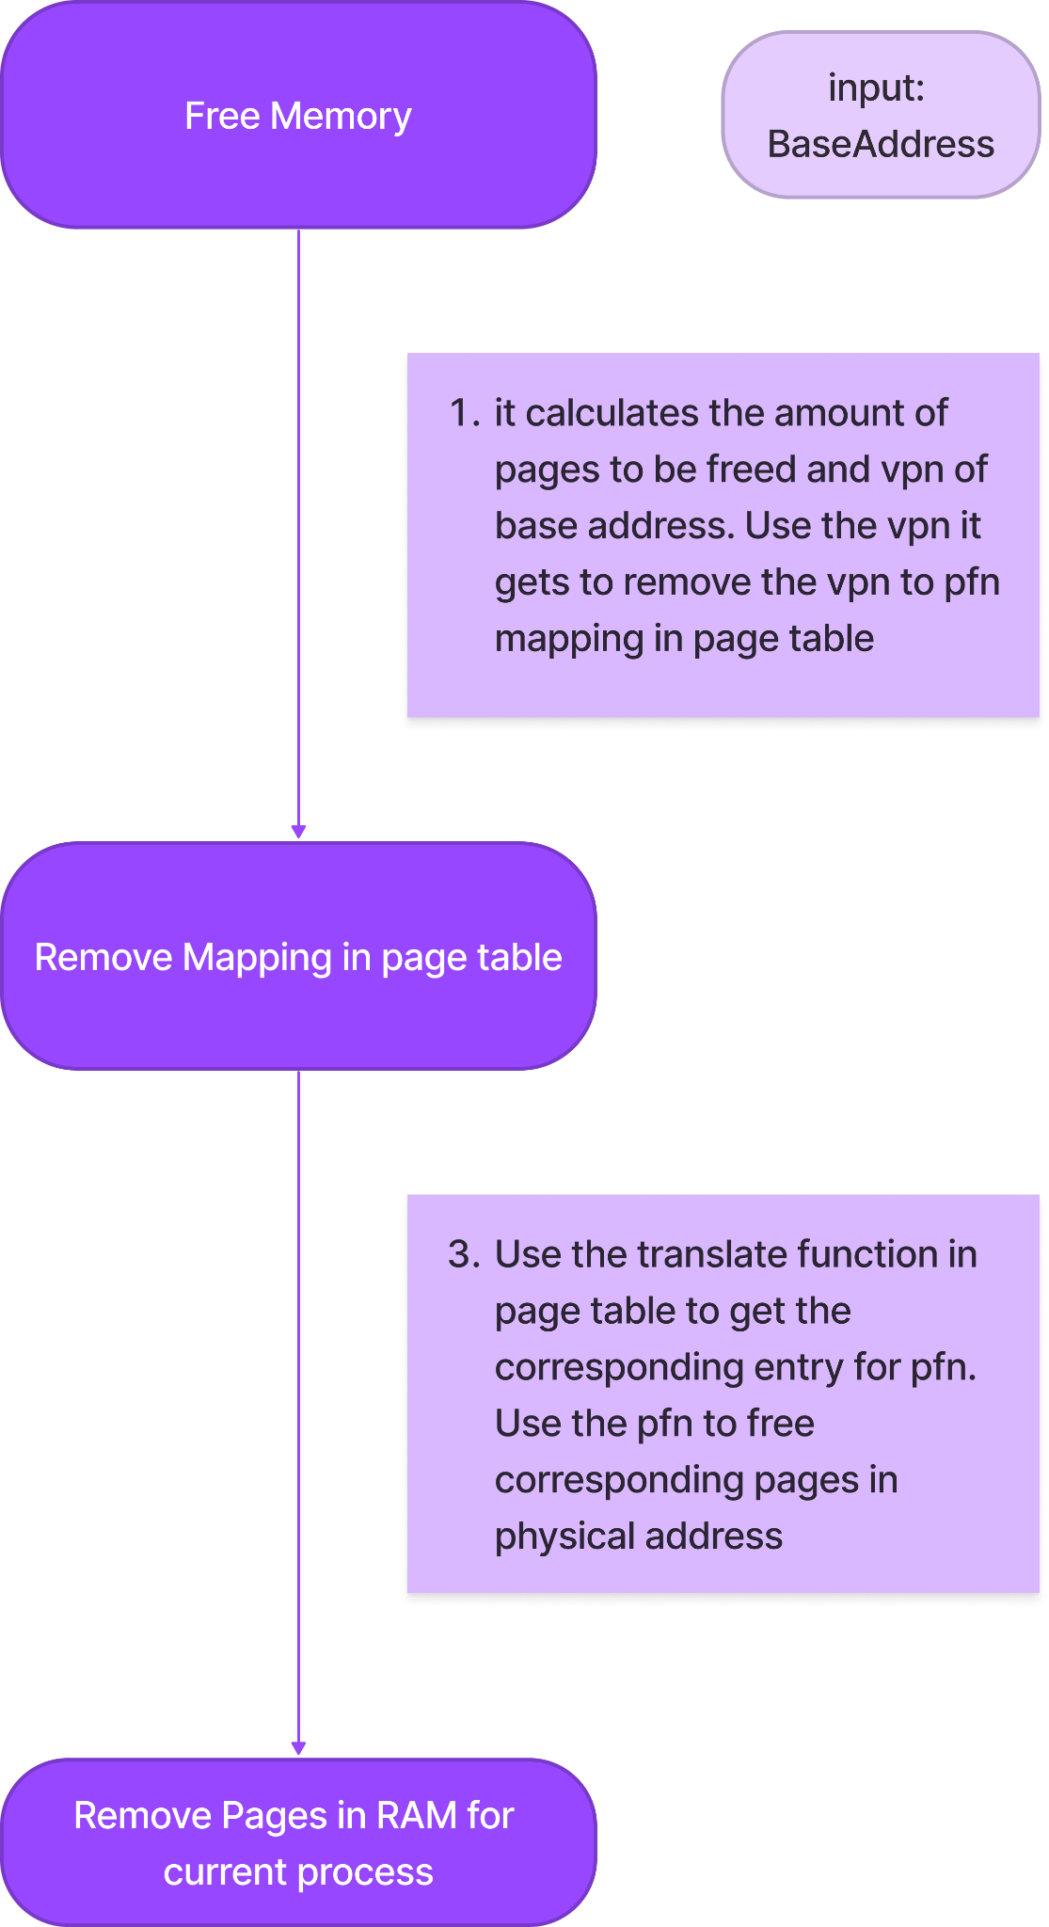
Free memory
Free the amount of memory starting from base address to heap top.
It removes the vpn to pfn mapping in page table and update the free frames in physical memory

Slide 9
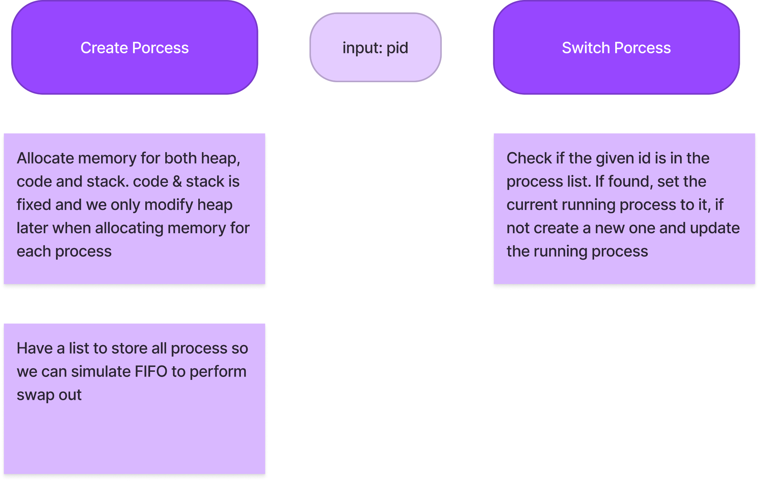
Create and Switch process

Slide 10
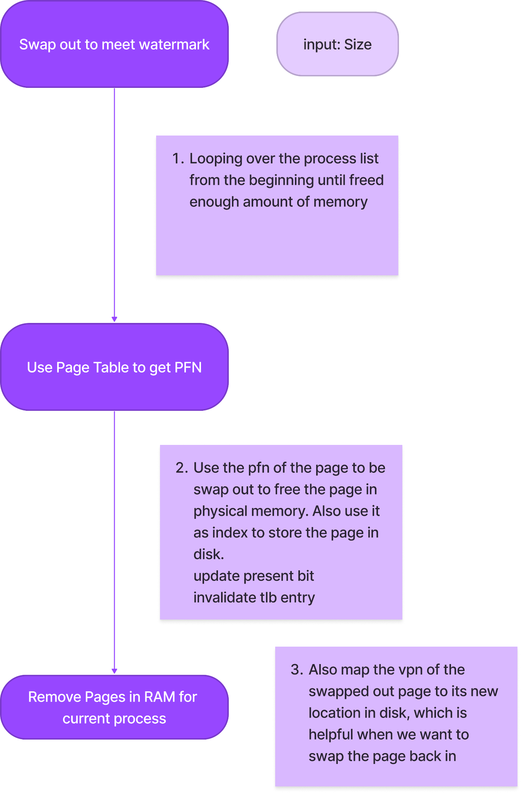
Swap out
Swap out page from physical memory to disk if there is not enough space in physical memory
Invalidate corresponding TLB entry & Update present bit of the page table of current running process

Slide 11
Two-Level Translation Lookaside Buffers
Current Implementation
L1 miss, look up in L2
If found, insert the entry into L1
L2 miss
OS goes to
page table
L1 Private
flush all upon process switch
64 entries
L2 Shared for multiple processes
selective flushing
For 1 process
256 entries
For 1 process
256 entries
For 1 process
256 entries
For 1 process
256 entries

Slide 12
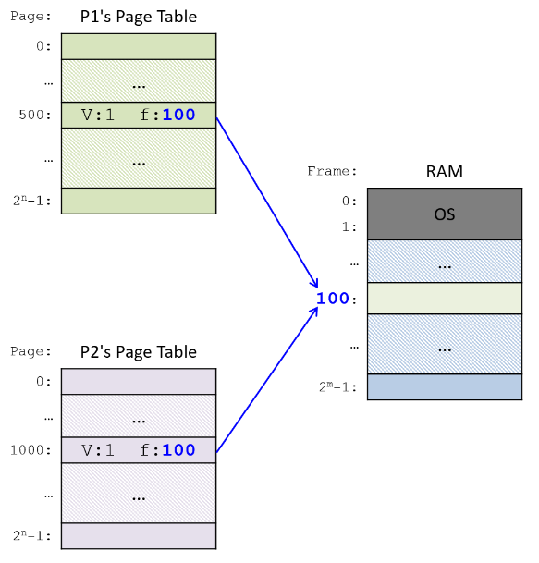
Shared TLB entries can be designed for shared physical pages among different processes (e.g. shared libraries), so that the same address mapping does not appear multiple times in TLB.
When designing the corresponding flushing policies, avoid flushing these shared entries to increase TLB hit rate.
Two-Level Translation Lookaside Buffers
Future implementation: Considering shared TLB entries

Slide 13
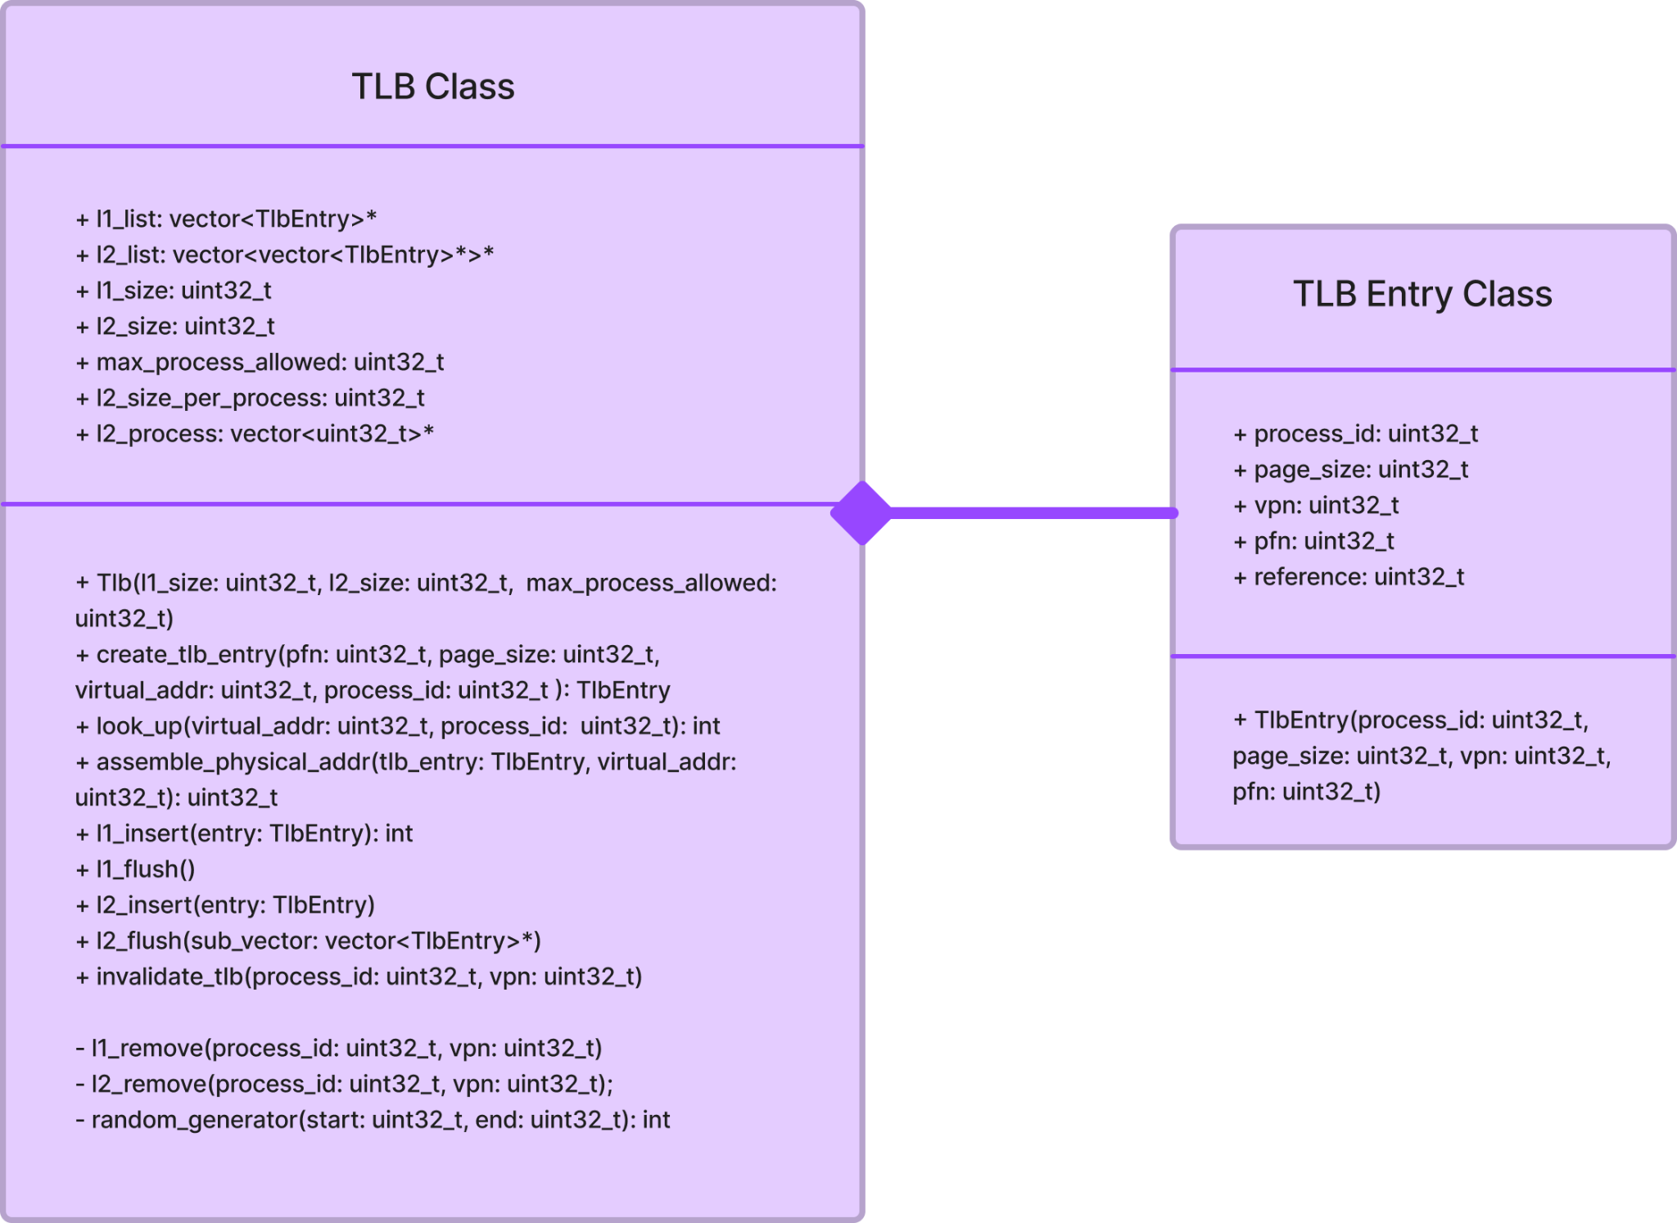
TLB
Main functionalities
Look up (vpn-pfn)
Assemble physical address
Insert
Flush (FIFO and Random)
Invalidate

Slide 14
TLB
Current improvements
Use process ID (ASID) instead of an additional data structure to identify a process in TLB
Add FIFO policy
Users can modify
L1 and L2 sizes
Number of processes allowed in L2
One level or two levels of TLBs

Slide 15
Two-level page table
Main functionalities
Map vpn to pfn
Translate virtual address
If not present, inform os to swap in
Remove mapping when memory is freed
Update present bit when swap out

Slide 16
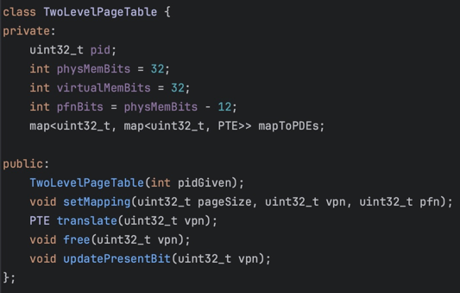
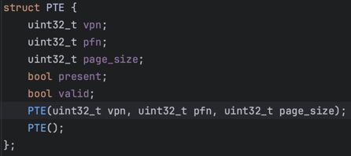
Two-level page table

Slide 17
Test generator
At each time step: 1. Access code
2. Access stack
3. Access heap
4. Allocate memory
5. Free memory
6. Switch process
Parameters: locality and max memory usage.
Program behavior simulation:
Serial, loop, function call.

Slide 18
Example
0 alloc 0x8000
0 access_stak 0xffffffff
0 access_heap 0x40ffff
0 access_heap 0x407331
0 free 0x408000
0 access_heap 0x407fff
0 access_stak 0xffffffff
0 access_heap 0x407fff
0 alloc 0x1000

Slide 19
Hypotheses
Does two-level TLB increases hit rate, compared to one-level TLB?
Does supporting different page sizes increase hit rate, compared to only supporting a fixed page size (4KB)?
How does TLB replacement policy impact performance?

Slide 20
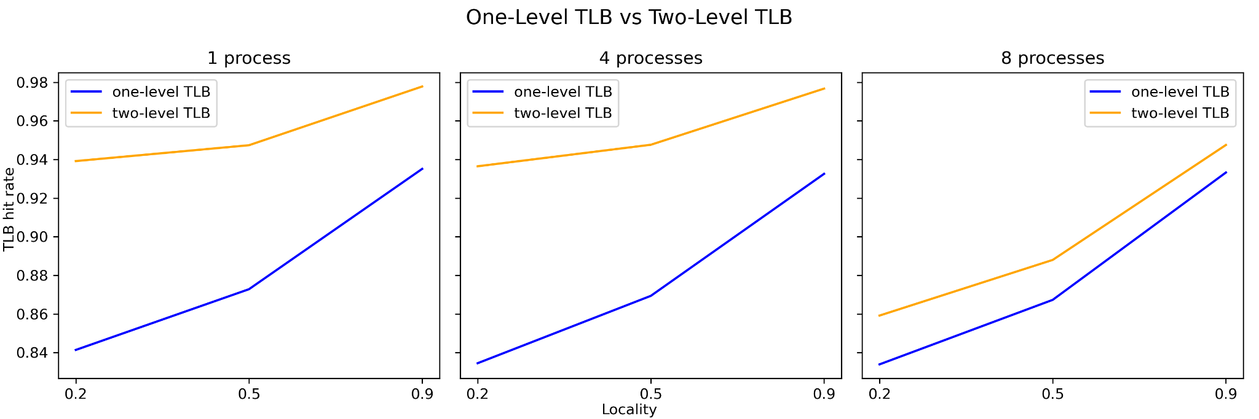
Results – two level TLB vs one level TLB

Slide 21
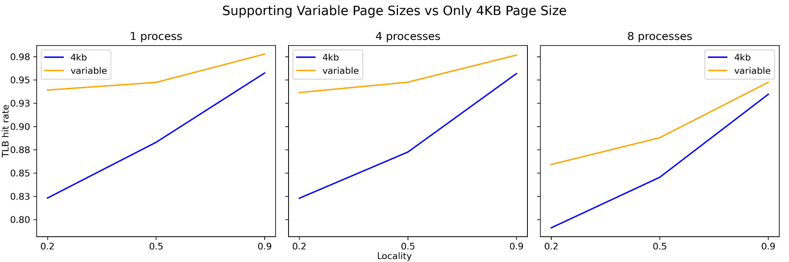
Results – variable vs fixed page sizes

Slide 22
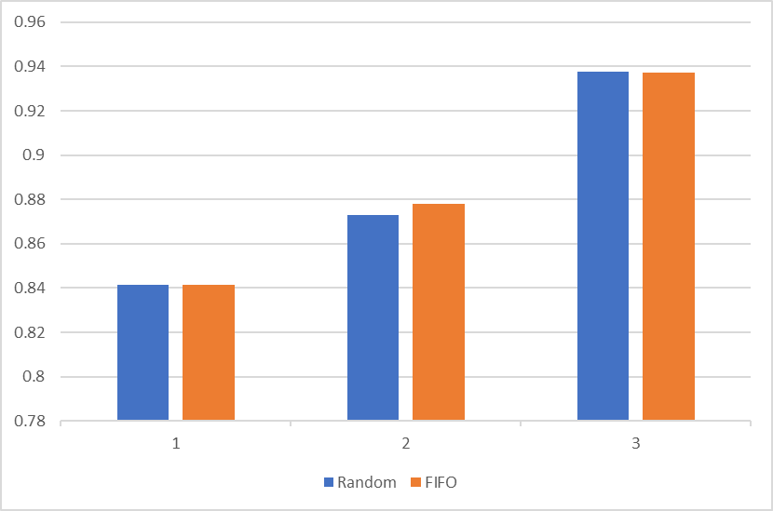
Results – random vs FIFO policy
(Single process under 2 level TLB + variable page sizes)
TLB hit rate
Locality

Slide 23
Future work
Include LRU policy
Add bug free disk
Considering dirty bit

